Slide 1

VISVESVARAYA TECHNOLOGICAL UNIVERSITY Department of Computer Science and Engineering
Subject : - Mini project [BCS586]
A Presentation on
ONLINE VOTING SYSTEM
A Modern Approach to Secure and Efficient Voting Systems
Program Coordinator: Dr G.F. Ali Ahammed
Dept of CS&E VTU CPGS Mysuru
Team Members:
D P Kavya (4VZ22CS009)
Mayank (4VZ22CS016)
Pratheeksha R M (4VZ22CS021)
Sharanabasavaraj (4VZ22CS025)

Slide 2

INTRODUCTION
What is Online voting?
Online voting is a digital system that allows voters to cast their votes through electronic means, typically via the internet, instead of traditional paper ballots or physical voting machines.

Slide 3

Problem Statement
The traditional voting system faces several critical challenges that hinder its efficiency and reliability.
Limited accessibility prevents remote voters, differently-abled individuals, and others from participating fully in elections.
Additionally, high operational costs due to logistics, staffing, and materials strain resources, especially in large-scale elections.
The system is prone to human errors, such as miscounts and inaccuracies, which can undermine trust in the process. Furthermore, delayed results caused by manual vote counting create uncertainty and reduce confidence in the election outcomes.

Slide 4

Objective of the Project:
The primary goal of this project is to develop a secure, user-friendly, and efficient online voting platform. This platform aims to maintain the integrity of the electoral process while improving accessibility and scalability.

Slide 5
Existing System
Manual Voting Process
Time-Consuming and Error-Prone Counting
Accessibility Issues
High Costs
Delayed Results
Proposed System
Digital Voting Platform
Automated Counting
Enhanced Accessibility
Cost-Effective
Instant Results
Security Measures

Slide 6
Project Methodology
Phase 1: Requirement Analysis
Gathering system requirements
Identifying user roles
Phase 2: Design
Database schema and user interface wireframes
Phase 3: Development
Using a stack including HTML, CSS, JavaScript, and Express.js
Phase 4: Testing and Deployment
Unit testing, integration testing, and live deployment

Slide 7
Implementation
Frontend:
Technologies: HTML, CSS, JavaScript and Embedded JavaSript
Features: Responsive design, intuitive user experience
Backend:
Technologies: Express.js, Node.js
Features: API development, database connectivity
Database:
Technology: MYSQL
Features: Secure and scalable data storage

Slide 8

Advantages of Online Voting
Increased voter turnout due to accessibility
Cost-effective compared to paper-based systems
Instant result computation
Enhanced security and transparency

Slide 9
Challenges and Limitations
Cybersecurity concerns
Digital literacy barriers
Dependence on stable internet connectivity
Potential resistance to change from traditional systems
Future Enhancements
Integration with blockchain for enhanced security
Biometric authentication
Mobile application support
AI-based fraud detection systems

Slide 10
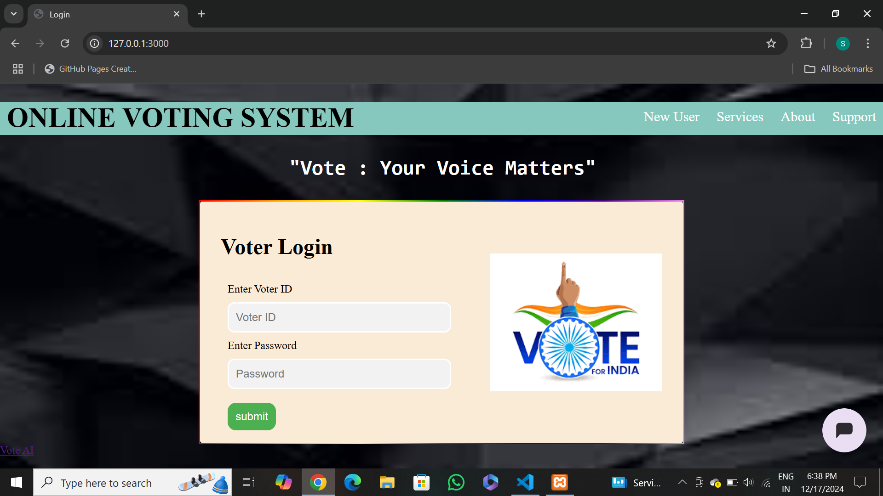
Snapshots
1. User Login

Slide 11
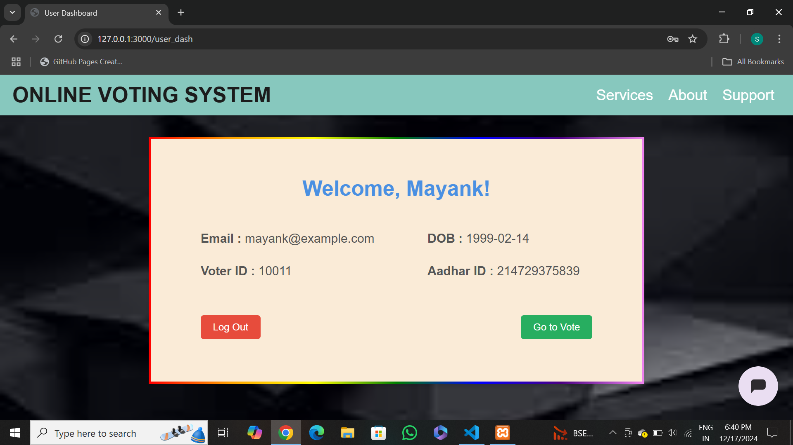
Snapshots
2. User Dashboard

Slide 12
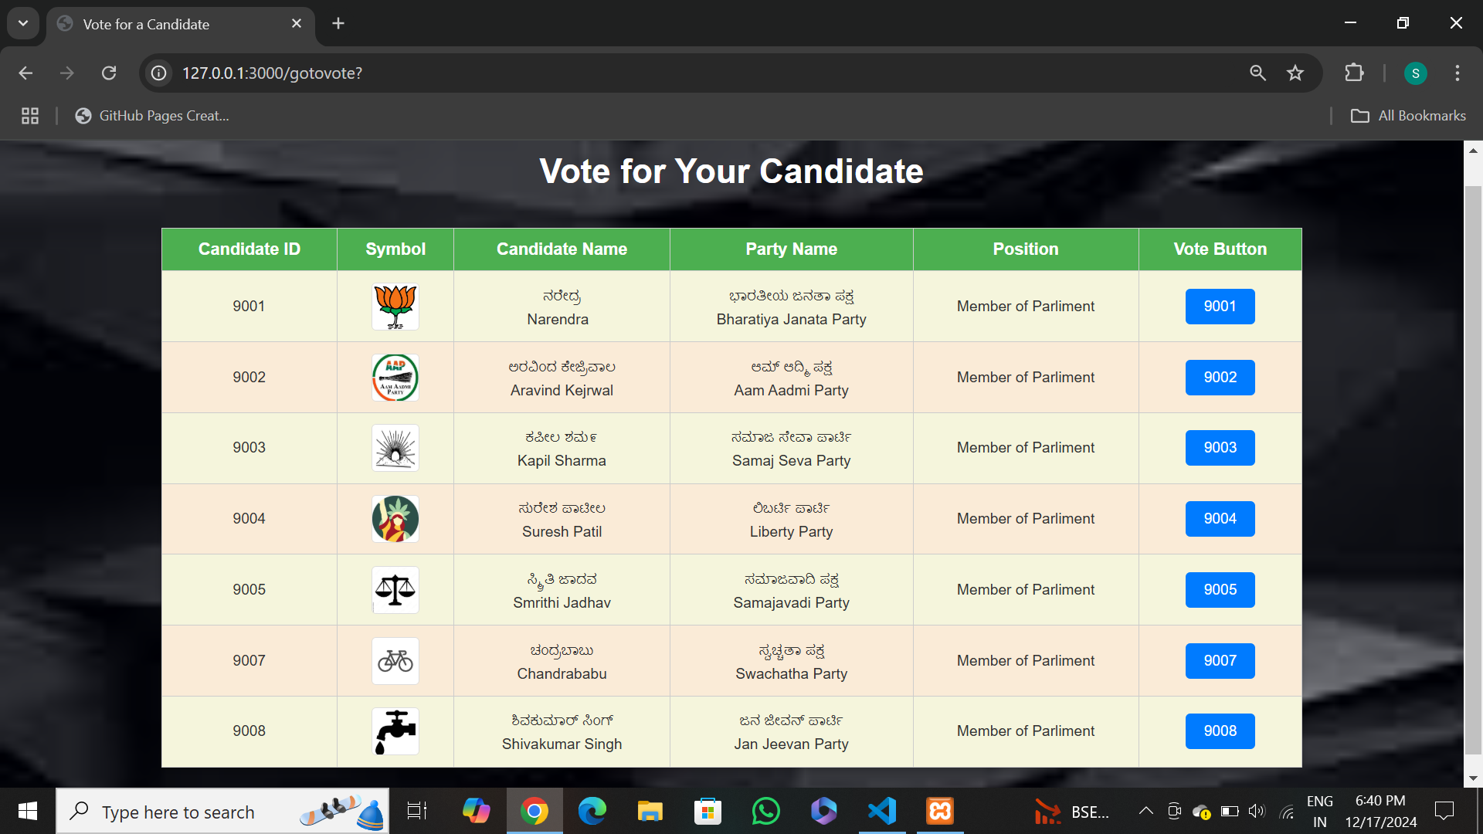
Snapshots
3. Candidate List

Slide 13
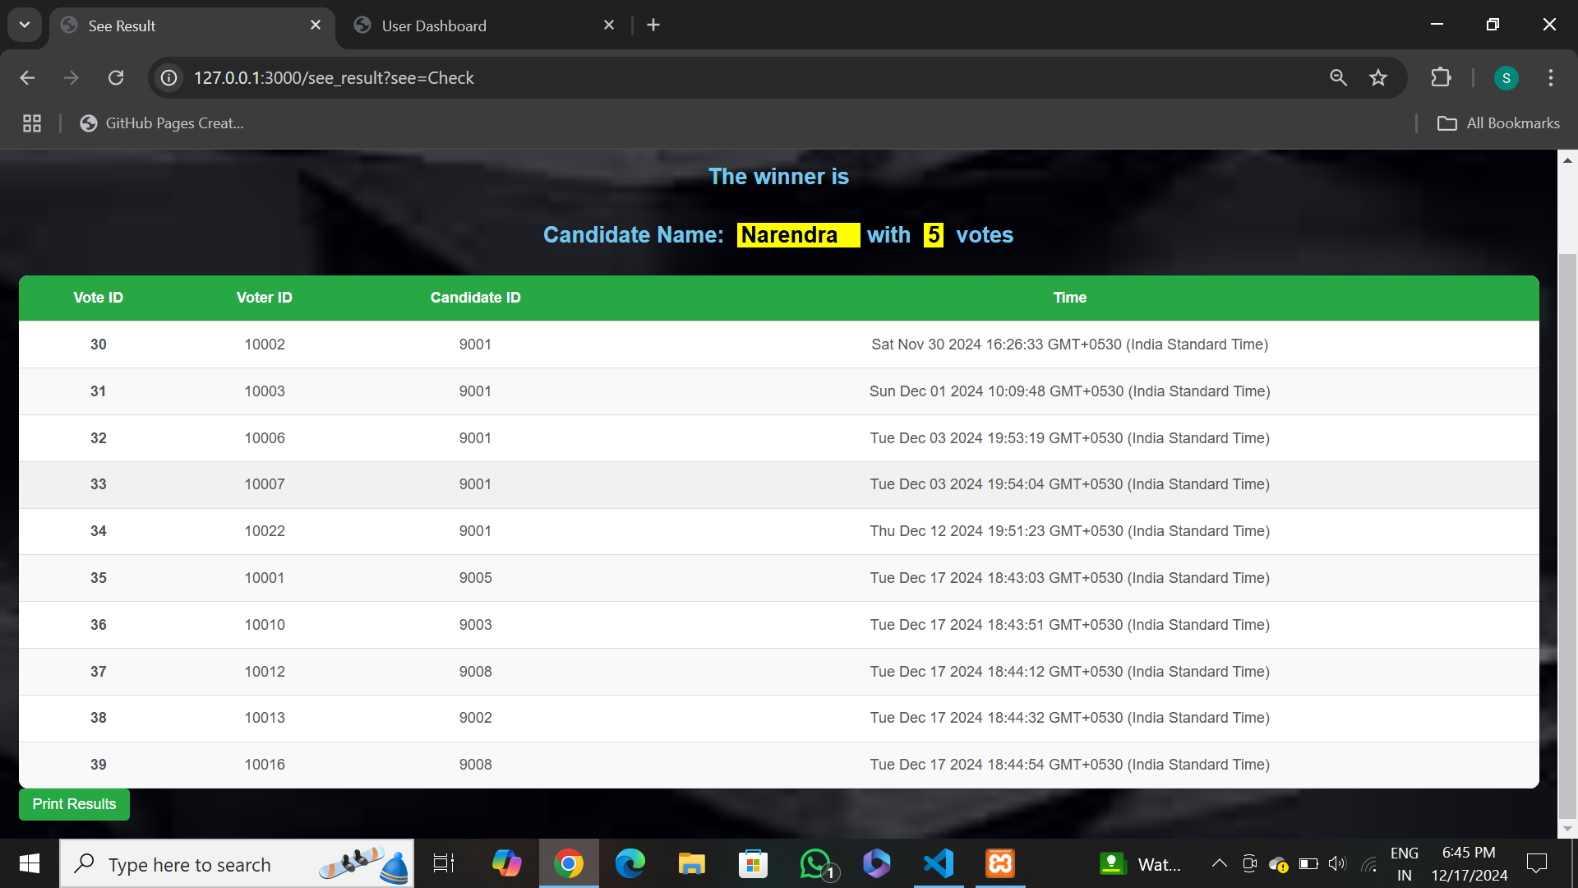
Snapshots
4. Result List in Admin Module

Slide 14

Conclsion
The Online Voting Project offers a modern solution to the limitations of traditional voting systems by enhancing accessibility, accuracy, and efficiency. With features like automated counting and real-time results, it ensures faster and more transparent elections. The system is cost-effective, secure, and user-friendly, reducing barriers for voters. By adopting such technology, we can strengthen the democratic process and improve voter participation. This project also sets the stage for future advancements like blockchain integration and biometric authentication. It is a step towards a more inclusive and reliable voting system.

Slide 15

THANK YOU

